Slide 1


Bird Strike Analysis for Aviation Safety: A Data-Driven Approach
This project evaluates comprehensive bird strike data from 2000-2013 to identify trends, mitigate risks, and enhance operational protocols across the aviation sector.
Safety Improvements
Regulatory Compliance
Cost Reduction
Risk Management
Wildlife Conservation
Operational Efficiency
KPI and Insights
Overall Summary and Recommendations

Slide 2
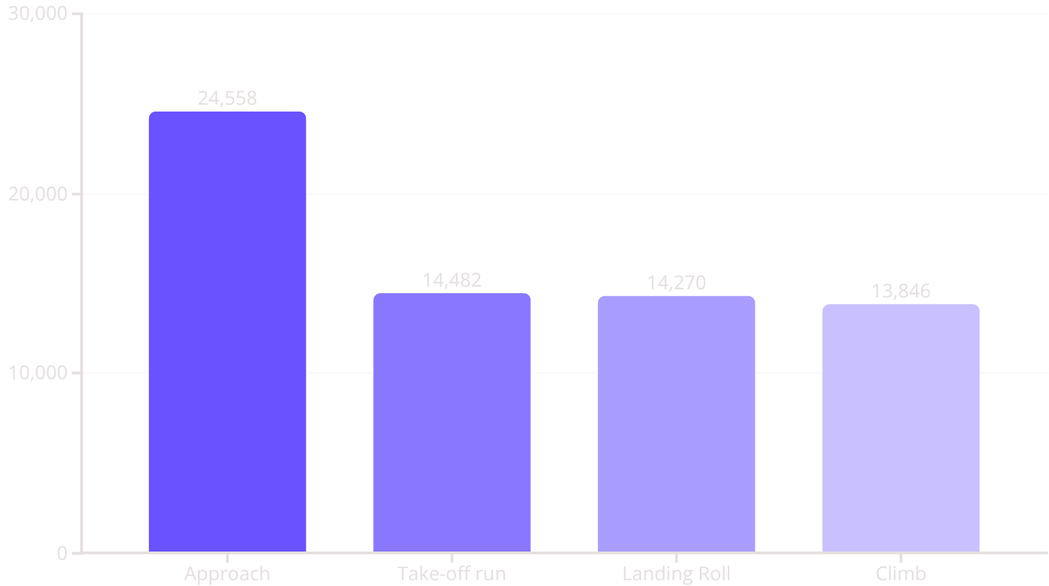
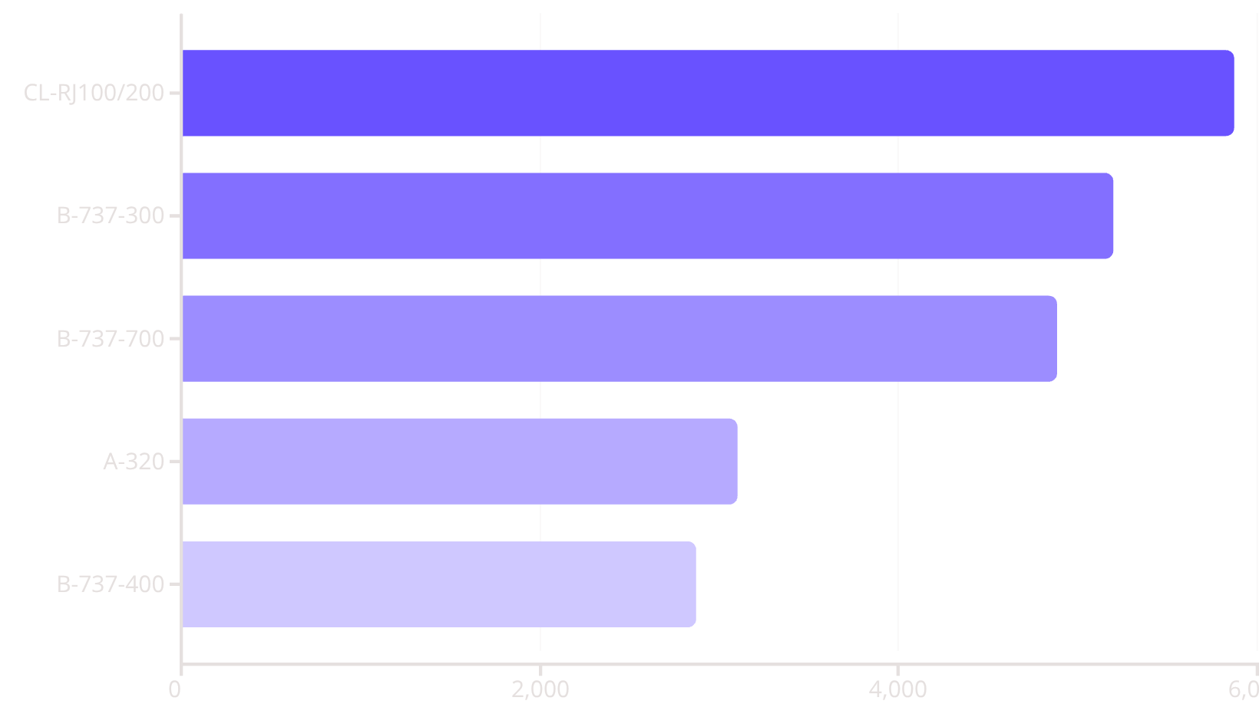
Safety Improvements
Understanding when and where strikes occur is critical for effective hazard mitigation strategies.
Strikes by Flight Phase
Top Affected Aircraft Models

Slide 3
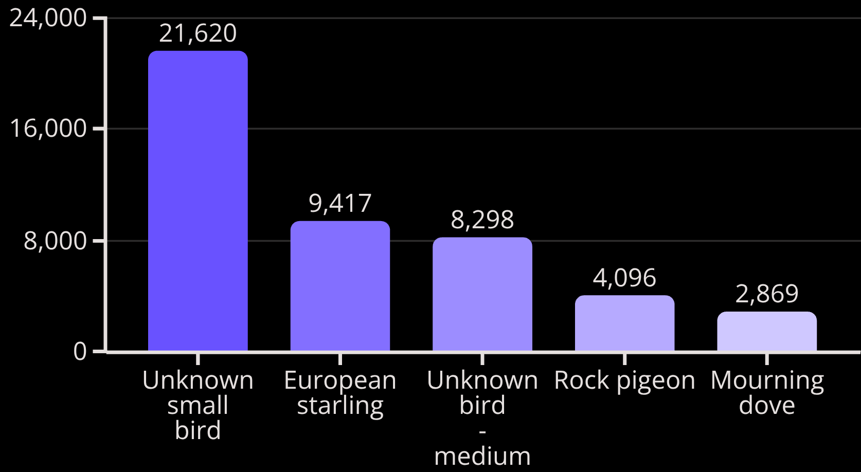

Wildlife Conservation
Top Species Involved in Strikes
Incident Outcome Types
No impact
Precautionary Landing
Aborted Take-off
Engine Shut Down

Slide 4

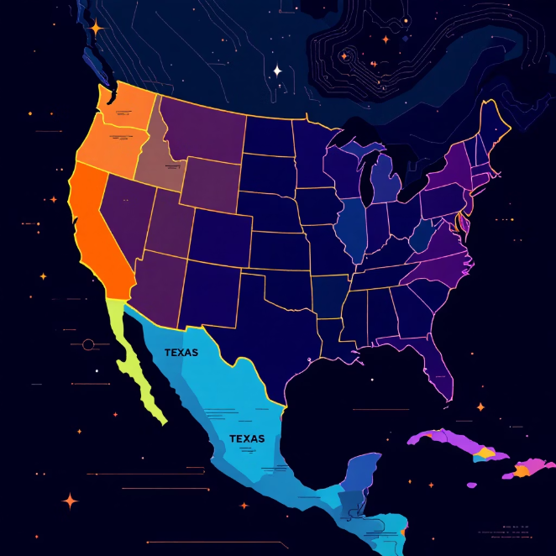
Operational Efficiency
Severe Schedule Disruption
High-Volume States
Majority No Impact
The most severe disruptions involve precautionary landings (2,858), aborted take-offs (1,178), and engine shutdowns (1,153).
California, Texas, and Florida lead in total recorded bird strikes
Most recorded strikes (30,056 'Other' and 733 'No Impact') do not immediately disrupt flight.
Flight Schedule Impact
Top 5 States by Strike Volume
Even "No Impact" strikes require inspections, consuming valuable time and resources.
California: 7,103 strikes
Texas: 6,043 strikes
Florida: 4,077 strikes
Pennsylvania: 3,527 strikes

Slide 5
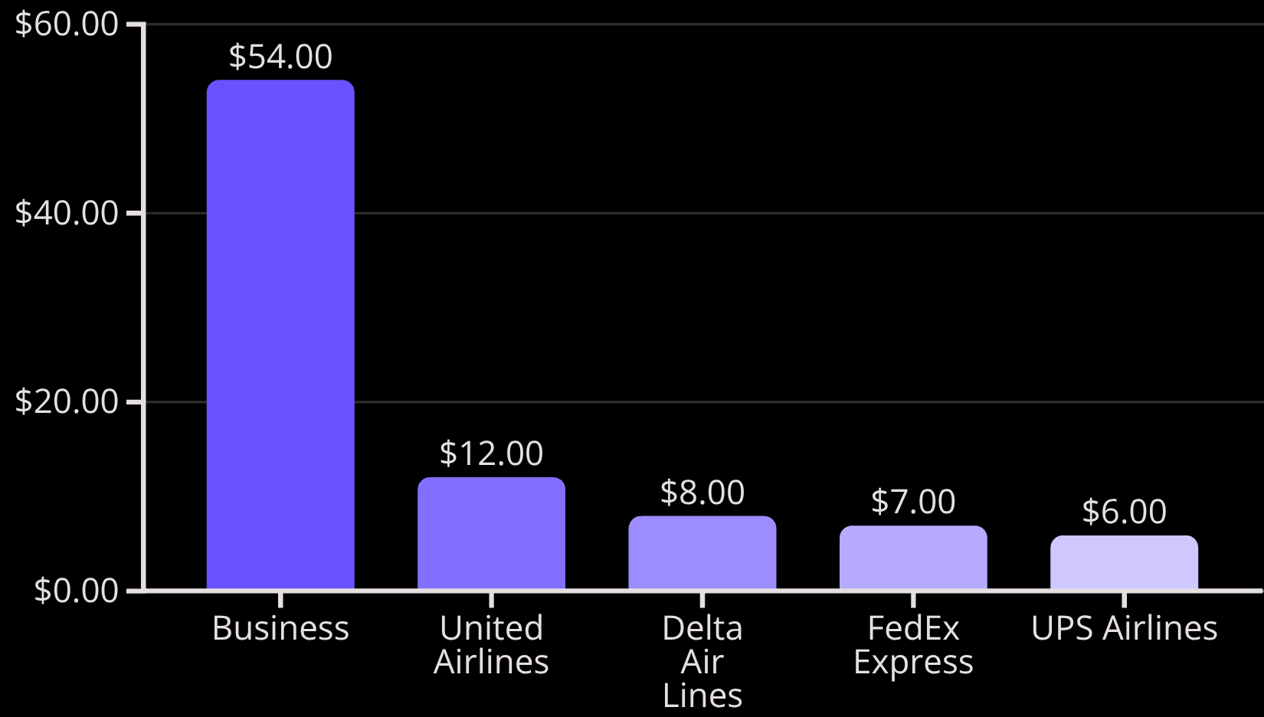
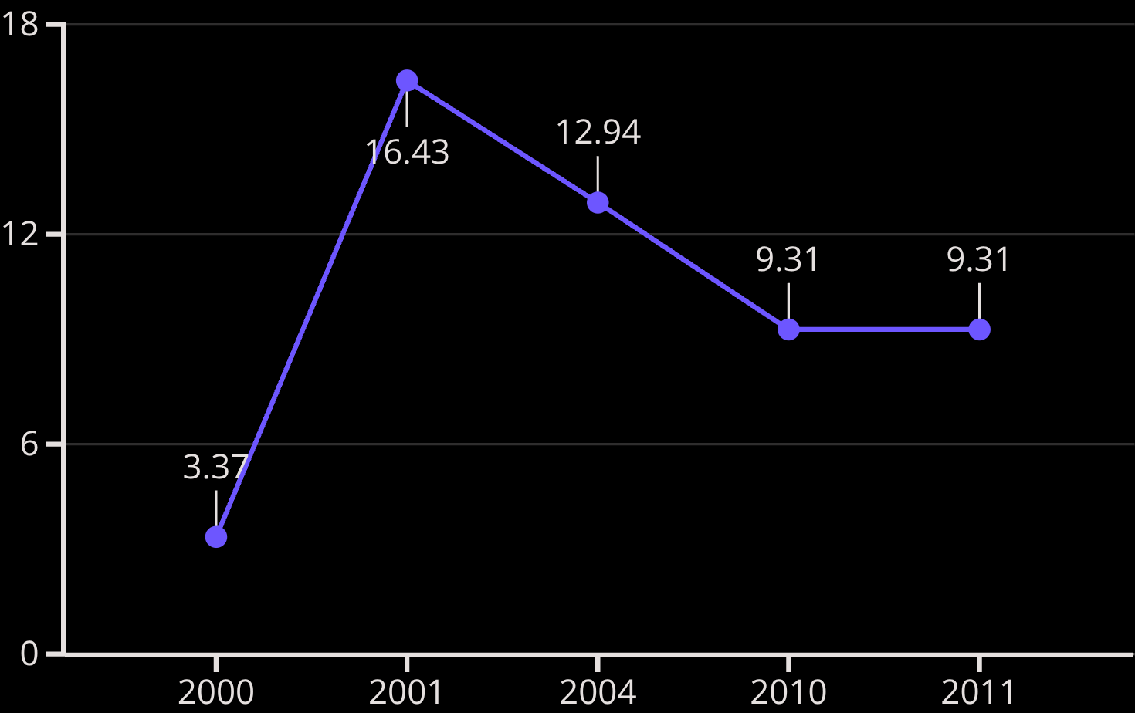

Cost Reduction
Annual Cost Fluctuation (Percentage of Total)
Total Costs by Major Airline ($ Millions)
The total cost to the industry exceeds $140 million over the analyzed period.

Slide 6
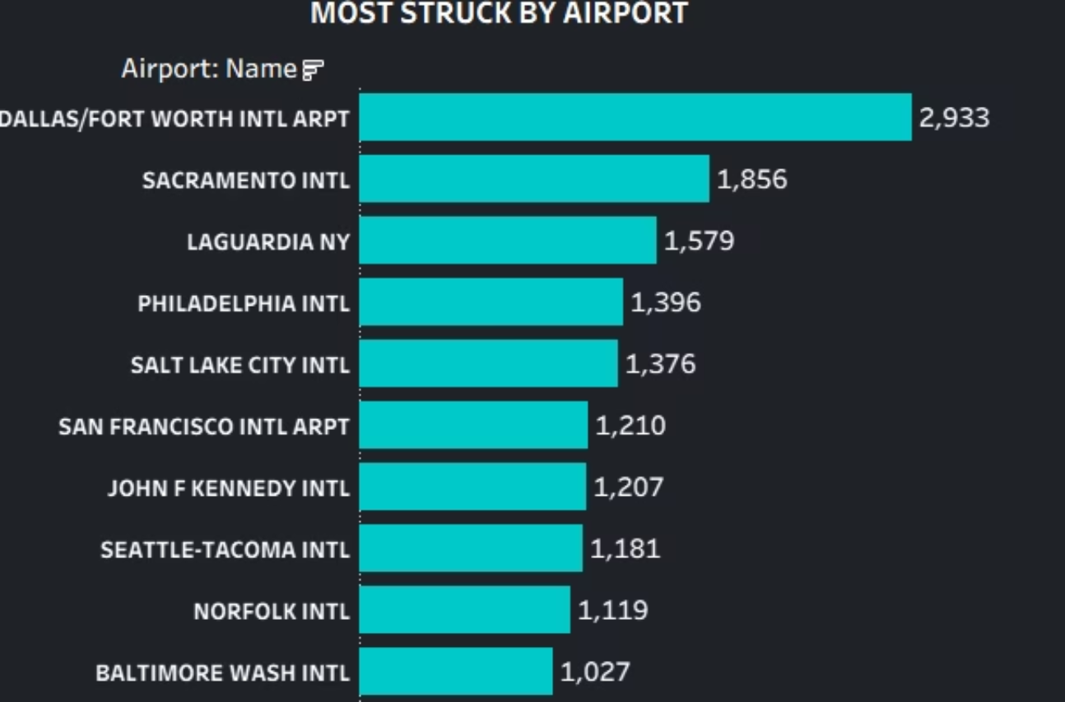
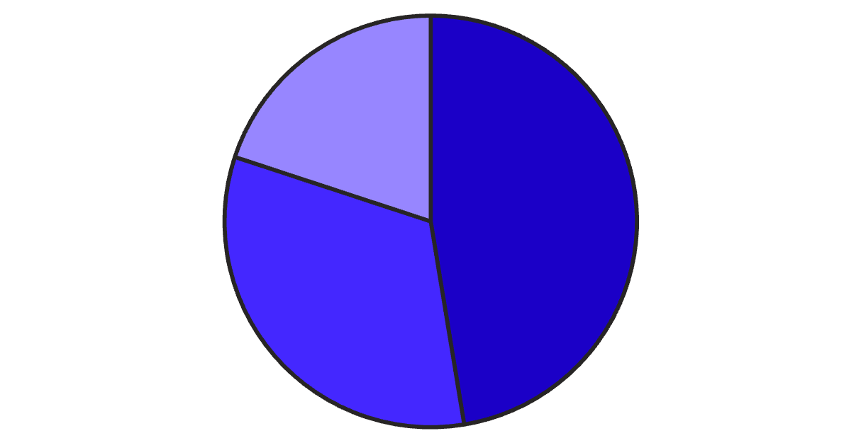
Regulatory Compliance
Accurate reporting is the foundation of effective mitigation programs. We observe positive trends, but clear-sky strikes remain a persistent threat.
Reporting Accuracy Improvement
Strikes by Sky Conditions
The linear trend indicates a steady improvement in the quality and frequency of bird strike reports filed between 2000 and 2011, peaking in accuracy around 2010.
Despite potential visibility issues in overcast conditions, nearly half of all strikes occur when the sky is clear or visibility is optimal.
No Cloud
Some Cloud
Overcast

Slide 7
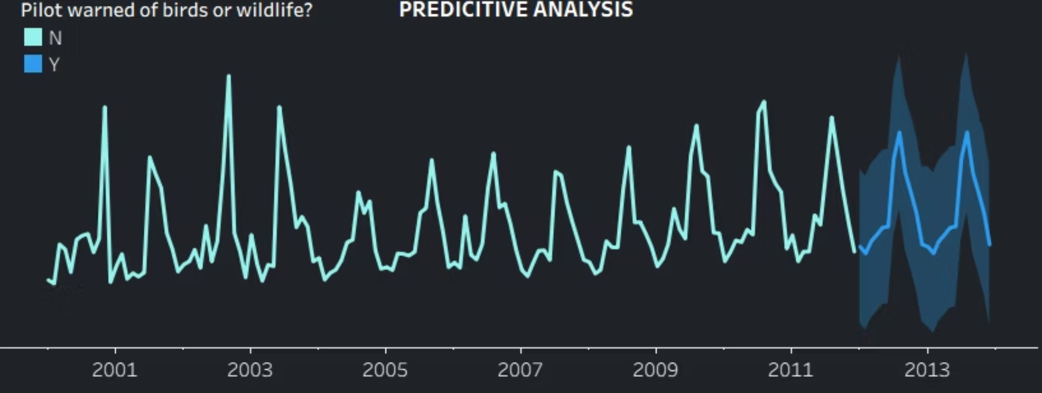
Communication and Training
Pilot Warning Effectiveness by Flight Phase
Predictive Warning Trend
Flight Phrase
Warned : Yes
No
Approach
14K
11K
Take-off run
7K
7K
Landing Roll
8K
6K
Climb
8K
6K

Slide 8
Key Performance Indicators and Strategic Insights
68,649
345
21
2,933
Total Strikes Recorded
Unique Species Involved
People Injured
Highest Strike Location
Average Annual Cost
Frequent Sky Condition
Approximately $272,727
47.40% of strikes occurred under No Cloud conditions
Insight: Prioritize low-altitude operations, Dallas/Fort Worth, and strategies effective during clear visibility conditions.

Slide 9



Overall Summary and Strategic Recommendations
Habitat Management
Enhanced Monitoring
Pilot Warning Training
Implement targeted habitat management to reduce airport-area nesting and feeding grounds for birds.
Install bird detection radar at high-risk airports (e.g., Dallas/Fort Worth) for real-time hazard alerts.
Develop mandatory training modules focused on low-altitude avoidance techniques and immediate hazard reporting.
Operational Focus
Inspection Protocols
Deploy full preventive measures during critical Approach and Landing phases to protect aircraft assets.
Mandate regular, detailed aircraft inspections following any suspected or recorded strike, regardless of impact severity.

